Slide 1


11th EBL NBO Officers’ Seminar
Dealing with Covid-19
Gilad Ofir & Oryah Meir
European Bridge League

Slide 2

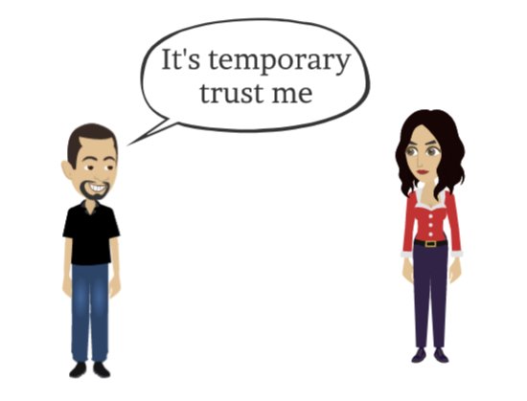
11th EBL NBO Officers’ Seminar
March
ACTIVITIES CAME TO A COMPLETE STANDSTILL
European Bridge League

Slide 3
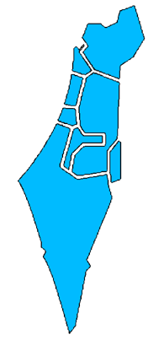

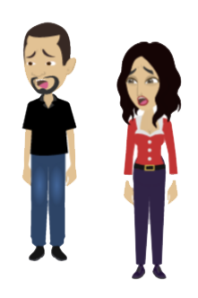
11th EBL NBO Officers’ Seminar
March
European Bridge League

Slide 4
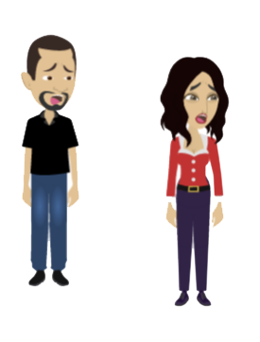

11th EBL NBO Officers’ Seminar
March
Youth projects
Team trainings
Collaborations
Bridge Festival
European Bridge League

Slide 5
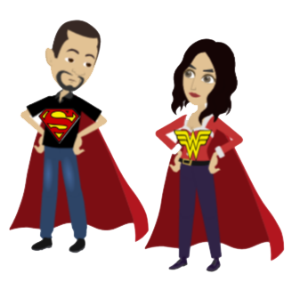
11th EBL NBO Officers’ Seminar
March
Youth projects
Team trainings
Collaborations
Bridge Festival
European Bridge League

Slide 6

11th EBL NBO Officers’ Seminar
March
STEPS TAKEN TO “REVIVE” THE BRIDGE INDUSTRY
1. Receive permission from BBO
2. Master the new platform
3. Conduct Free experimental tournaments
4. Create video tutorials & manuals
5. Customer’s support
European Bridge League

Slide 7
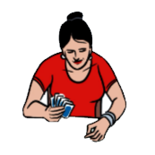



11th EBL NBO Officers’ Seminar
April
RESUSCITATION JAB FOR PLAYERS
1. Paid tournaments
2. Local Master Points
3. National Master Points
European Bridge League

Slide 8
11th EBL NBO Officers’ Seminar
April
RESUSCITATION JAB FOR THE CLUBS
1. Financial aid
2. Clubs conducting independent
online tournaments
3. Massive TD training
European Bridge League

Slide 9
11th EBL NBO Officers’ Seminar
May
NATIONAL CHAMPIONSHIPS
The 1st Online Israel Senior
Championship
2. Additional Online
National Championships
European Bridge League

Slide 10

11th EBL NBO Officers’ Seminar
July
INTERNATIONAL BRIDGE ACTIVITIES
6,300 participations
European Bridge League

Slide 11
11th EBL NBO Officers’ Seminar
October
ARRANGING ONLINE NATIONAL & INTERNATIONAL BRIDGE ACTIVITIES
First Online Team competition:
The National Cup
European Bridge League

Slide 12
11th EBL NBO Officers’ Seminar
November
ARRANGING ONLINE NATIONAL & INTERNATIONAL BRIDGE ACTIVITIES
First Teams League competition
European Bridge League

Slide 13

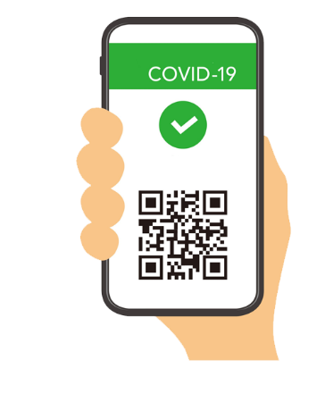
11th EBL NBO Officers’ Seminar
February
BACK TO FRONTAL ACTIVITY
IN
European Bridge League

Slide 14

11th EBL NBO Officers’ Seminar
April
HYBRID AGE
European Bridge League

Slide 15
11th EBL NBO Officers’ Seminar
June
IBF TERMINATES ITS ONLINE ACTIVITIES
CLUBS | IBF | ACTIVITY
✓ |  | Online
✓ | ✓ | Frontal
European Bridge League

Slide 16



11th EBL NBO Officers’ Seminar
Clubs Status
8
76
9
8
54
5
9
European Bridge League

Slide 17


11th EBL NBO Officers’ Seminar
December
OMICRON BLITZ
European Bridge League

Slide 18
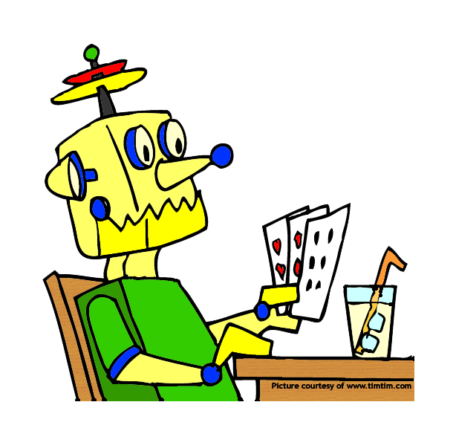
11th EBL NBO Officers’ Seminar
ISSUES WHICH REQUIRED OUR SPECIAL ATTENTION DURING THE LAST 2 YEARS
THE ENTRY OF ROBOTS INTO OUR LIVES
Unfair advantage?!
European Bridge League

Slide 19
11th EBL NBO Officers’ Seminar
ISSUES WHICH REQUIRED OUR SPECIAL ATTENTION DURING THE LAST 2 YEARS
ONLINE MASTER POINTS ALLOCATION
Should we allow it?
YES
European Bridge League

Slide 20
11th EBL NBO Officers’ Seminar
ISSUES WHICH REQUIRED OUR SPECIAL ATTENTION DURING THE LAST 2 YEARS
ONLINE MASTER POINTS ALLOCATION
Should we allow it?
How much to award?
YES
LESS THAN FRONTAL TOURNAMENTS
European Bridge League

Slide 21
11th EBL NBO Officers’ Seminar
ISSUES WHICH REQUIRED OUR SPECIAL ATTENTION DURING THE LAST 2 YEARS
ONLINE MASTER POINTS ALLOCATION
Should we allow it?
How much to award?
Should we award MP in clubs’ competitions too?
YES
LESS THAN FRONTAL TOURNAMENTS
ONLY LOCAL MP
European Bridge League

Slide 22
11th EBL NBO Officers’ Seminar
ISSUES WHICH REQUIRED OUR SPECIAL ATTENTION DURING THE LAST 2 YEARS
ONLINE MASTER POINTS ALLOCATION
Should we allow it?
How much to award?
Should we award MP in clubs’ competitions too?
Should we award MP to a member playing with a non-member?
YES
LESS THAN FRONTAL TOURNAMENTS
ONLY LOCAL MP
NO
European Bridge League

Slide 23
11th EBL NBO Officers’ Seminar
ISSUES WHICH REQUIRED OUR SPECIAL ATTENTION DURING THE LAST 2 YEARS
ONLINE MASTER POINTS ALLOCATION
Should we allow it?
How much to award?
Should we award MP in clubs’ competitions too?
Should we award MP to a member playing with a non-member?
Should we award MP to a member playing with a robot?
YES
LESS THAN FRONTAL TOURNAMENTS
ONLY LOCAL MP
NO
YES
European Bridge League

Slide 24


11th EBL NBO Officers’ Seminar
ISSUES WHICH REQUIRED OUR SPECIAL ATTENTION DURING THE LAST 2 YEARS
ONLINE CHEATING - THE REAL PANDEMIC

Slide 25
11th EBL NBO Officers’ Seminar
ISSUES WHICH REQUIRED OUR SPECIAL ATTENTION DURING THE LAST 2 YEARS
MEMBERSHIP ISSUES
Digital services were accessible to members only
Zoom lectures on various topics not related to Bridge
Open Zoom meetings between members and the executive committee
Free online tournaments as a gift for the Israeli Independence Day
Despite our huge efforts, renewals dropped down by 1,500 members
European Bridge League

Slide 26
11th EBL NBO Officers’ Seminar
SUMMARIZING 2 YEARS OF ACTIVITY UNDER THE COVID CLOUD?
DAMAGES
Drastic decline in the Federation’s income
Significant decline in the number of members
A freeze on the youth program
A stop on Team trainings,
A cancellation of international activities,
Addiction to online tournaments
Decrease in clubs activity
A negative effect on the government’s subsidy for 2022
European Bridge League

Slide 27
11th EBL NBO Officers’ Seminar
SUMMARIZIN 2 YEARS OF ACTIVITY UNDER THE COVID CLOUD?
THE POSITIVE SIDE
Direct connection with the members
Introduce and integrate the golden age group to digital activity and services
Transform a crisis into an opportunity by creative thinking
Conduct the first online TDs course using Zoom software
European Bridge League

Slide 28

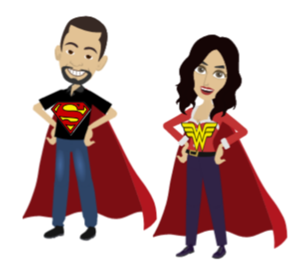
11th EBL NBO Officers’ Seminar
January
The internet is both our savior and our nightmare
European Bridge League

